Slide 1




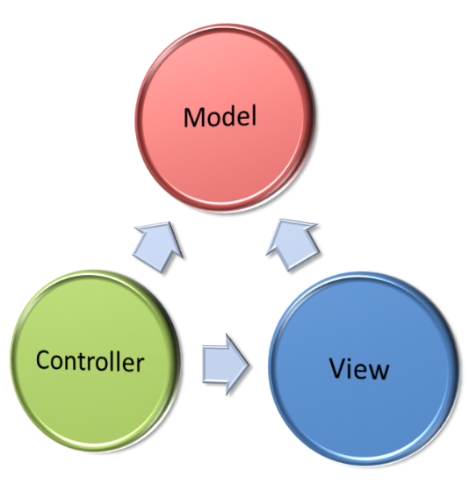

ASP.NET MVC Introduction
MVC, Models, Views, Controllers, ASP.NET
SoftUni Team
Technical Trainers
Software University
http://softuni.bg

Slide 2

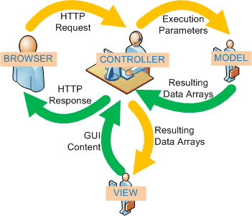
Table of Contents
The MVC Pattern
Model, View, Controller
The MVC Pattern for Web and Examples
ASP.NET MVC
Comparison with ASP.NET
ASP.NET MVC Advantages
Creating ASP.NET MVC Project
NuGet Package Management
Server Information with Glimpse

Slide 3
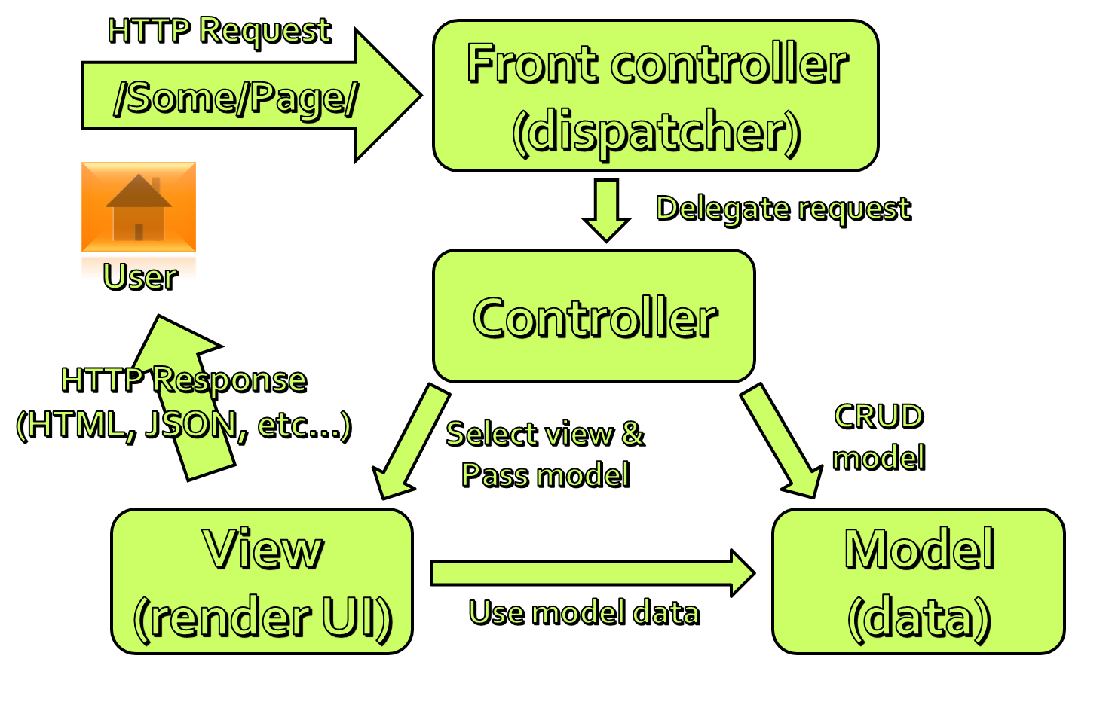
The MVC Pattern
Model-View-Controller

Slide 4
The MVC Pattern
Model-View-Controller (MVC) is a software architecture pattern
Originally formulated in the late 1970_{s} by Trygve Reenskaug as part of the Smalltalk
Code reusability and separation of concerns
Originally developed for desktop
Then adapted for internet applications

Slide 5

Model
Set of classes that describes the data we are working with
Rules for how the data can be changed and manipulated
May contain data validation rules
Often encapsulate data stored in a database
as well as code used to manipulate the data
Most likely a Data Access Layer of some kind
Apart from giving the data objects
It doesn't have significance in the framework

Slide 6


View
Defines how the application’s user interface (UI) will be displayed
May support master views (layouts)
May support sub-views (partial views or controls)
Web: Template to dynamically generate HTML

Slide 7
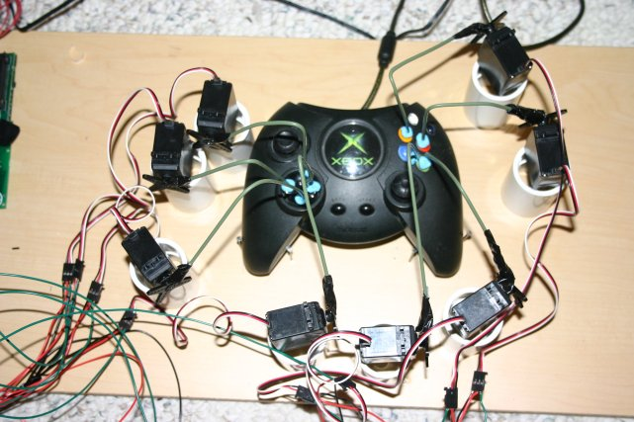
Controller
The core MVC component – holds the logic
Process the requests with the help of views and models
A set of classes that handles
Communication from the user
Overall application flow
Application-specific logic
Every controller has one or more "actions"

Slide 8
MVC Steps
Incoming request routed to Controller
For web: HTTP request
Controller processes request and creates presentation Model
Controller also selects appropriate result (view)
Model is passed to View
View transforms Model into appropriate output format (HTML)
Response is rendered (HTTP response)

Slide 9
The MVC Pattern for Web
HTTP Request
/Some/Page/
Front controller (dispatcher)
Delegate request
User
Controller
HTTP Response
CRUD model
Select view & pass data
View
(render UI)
Model (data)
Use model data

Slide 10
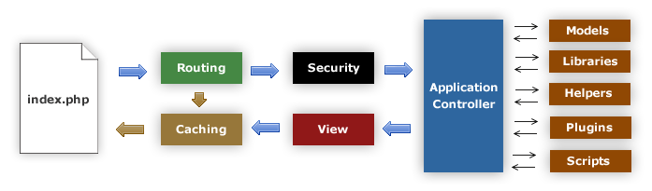
MVC Frameworks
PHP: CakePHP, CodeIgniter, Laravel
Java: Spring
Perl: Catalyst, Dancer
Python: Django, Flask, Grok
Ruby: Ruby on Rails, Camping, Nitro, Sinatra
JavaScript: AngularJS, JavaScriptMVC, Spine
ASP.NET MVC (.NET Framework)

Slide 11
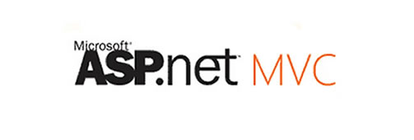
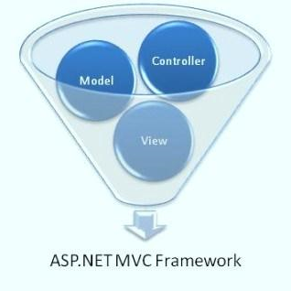
ASP.NET MVC

Slide 12
ASP.NET Core
ASP.NET WebForms
ASP.NET
MVC
Presentation
ASP.NET
Caching
.NET
Globalization
Pages
OWIN
Web API
Runtime
Profile
Roles
Identity
Routes
Handlers
Etc...

Slide 13
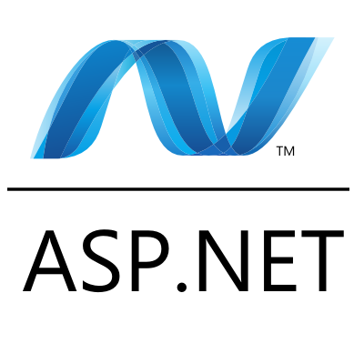
ASP.NET Web Forms
Stable and mature, supported by heaps of third party controls and tools
Event driven Web development
Postbacks
Viewstate
Less control over the HTML
Hard to test
Rapid development

Slide 14
ASP.NET History
Classic ASP introduced in late 1990's
2002 – ASP.NET 1.0 (Web Forms)
2008 – ASP.NET 3.5 (First version of MVC)
Two more versions in next two years
2010 – ASP.NET 4 (VS 2010, MVC 2.0, Razor)
2012 – ASP.NET 4.5 (First version of Web API, VS 2012)
2013 – SignalR
2013 – Visual Studio 2013, One ASP.NET, MVC 5
2014 – ASP.NET vNext, Roslyn, OWIN, …

Slide 15
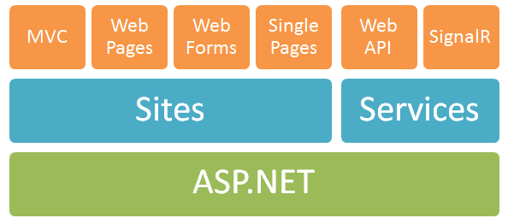
One ASP.NET
Web Forms
Component-based
ASP.NET MVC
Web Pages
Lightweight framework for dynamic content
Web API
Framework for building RESTful Web services
SignalR
Real-time client-server communication

Slide 16
ASP.NET MVC
Runs on top of ASP.NET
Not a replacement for Web Forms
Leverage the benefits of ASP.NET
Embrace the Web
SEO-friendly URLs, HTML 5, SPA
Adopt REST concepts
Uses MVC pattern
Conventions and Guidance
Separation of concerns

Slide 17
ASP.NET MVC (2)
Tight control over markup
Testable
Loosely coupled and extensible
Convention over configuration
Razor view engine
One of the greatest view engines
With intellisense, integrated in Visual Studio
Reuse of current skills (C#, EF, LINQ, JS, etc.)
Application-based (not scripts like PHP)

Slide 18
The ASP.NET MVC History
ASP.NET MVC 1.0
Released on 13 March 2009
ASP.NET MVC 2.0 (Areas, Async)
Released just one year later, on 10 March 2010
ASP.NET MVC 3.0 (Razor) – 13 January 2011
ASP.NET MVC 4.0 (Web API) – 15 August 2012
ASP.NET MVC 5.0 (Identity) – 17 October 2013
ASP.NET MVC 6.0 – soon enough

Slide 19
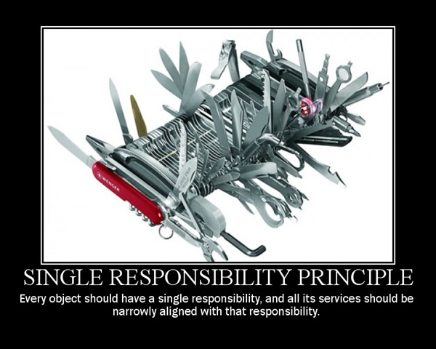
ASP.NET MVC: Separation of Concerns
Each component has one responsibility
SRP – Single Responsibility Principle
DRY – Don’t Repeat Yourself
More easily testable
TDD – Test-driven development
Helps with concurrent development
Performing tasks concurrently
One developer works on views
Another works on controllers

Slide 20
Extensible
Replace any component of the system
Interface-based architecture
Almost anything can be replaced or extended
Model binders (request data to CLR objects)
Action/result filters (e.g. OnActionExecuting)
Custom action result types
View engine (Razor, WebForms, NHaml, Spark)
View helpers (HTML, AJAX, URL, etc.)
Custom data providers (ADO.NET), etc.

Slide 21
Clean URLs
REST-like URLs
/products/update
/blog/posts/2013/01/28/mvc-is-cool
Friendlier to humans
/product.aspx?catId=123 becomes /products/chocolate/
Friendlier to web crawlers
Search engine optimization (SEO)

Slide 22
Community-Based
ASP.NET MVC, Web API, and Web Pages source code is available in CodePlex
http://aspnetwebstack.codeplex.com/
You can vote for new features in ASP.NET UserVoice site
http://aspnet.uservoice.com/forums/41199-general-asp-net
vNext is on GitHub
https://github.com/aspnet

Slide 23
MVC Pattern in ASP.NET MVC
HTTP Request
Web server
ASP.NET MVC Routing engine
/Users/Ivo/
Select controller and invoke action (method)
User
Controller
(C# class)
HTTP Response
(HTML, File, JSON, …)
Select view & pass data (model)
CRUD model
View engine
(Razor)
Model (POCO)
Use model data

Slide 24
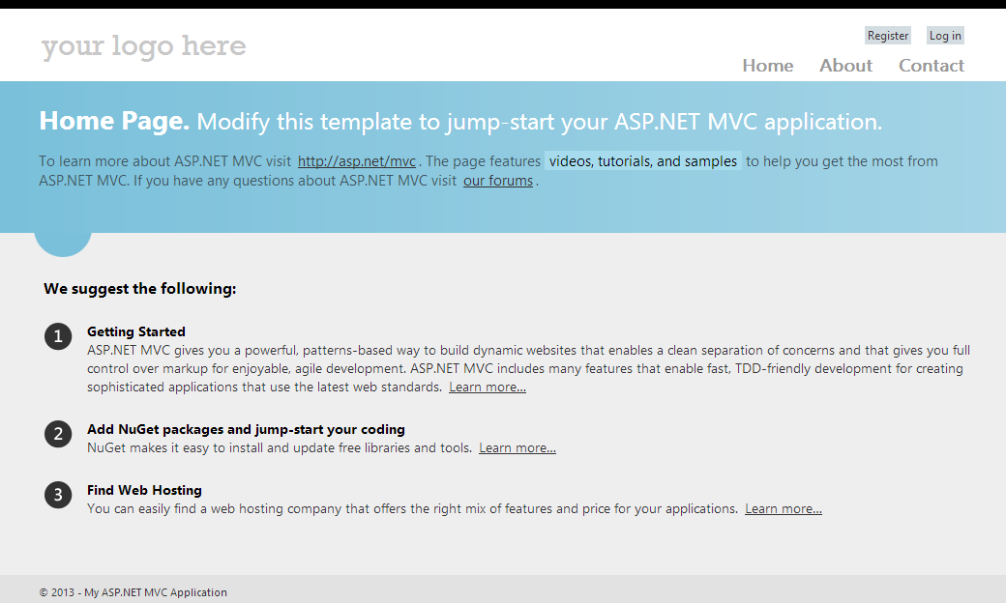
Creating ASP.NET MVC Project

Slide 25
The Tools
Tools that we need:
IDE: Visual Studio 2013 (2012 is also OK)
Framework: .NET Framework 4.5
Web server: IIS 8.5 (Express)
Data: Microsoft SQL Sever (Express or LocalDB)
Visual Studio installer will install everything we need
http://www.microsoft.com/visualstudio/eng/2013-downloads

Slide 26
The Technologies
Technologies that ASP.NET MVC uses
C# (OOP, unit testing, async, etc.)
ASP.NET
HTML(5) and CSS
JavaScript (jQuery, Bootstrap, AngularJS, etc.)
AJAX, Single-page apps
Databases (Microsoft SQL Server)
ORM (Entity Framework and LINQ)
Web and HTTP

Slide 27
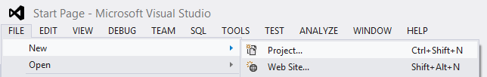
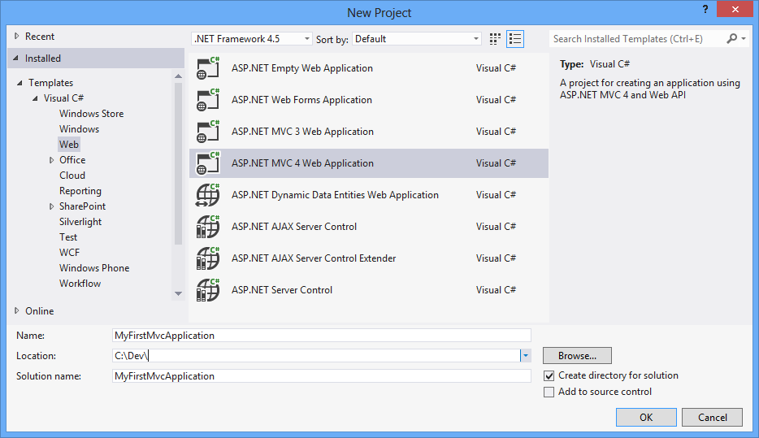
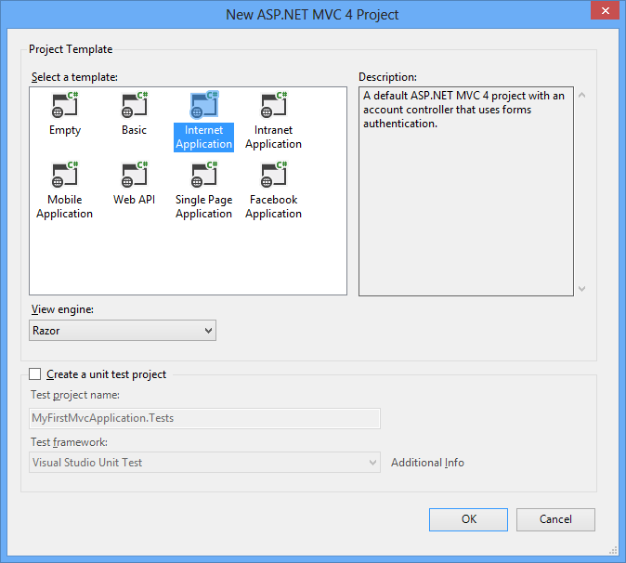
Visual Studio 2012: New Project

Slide 28
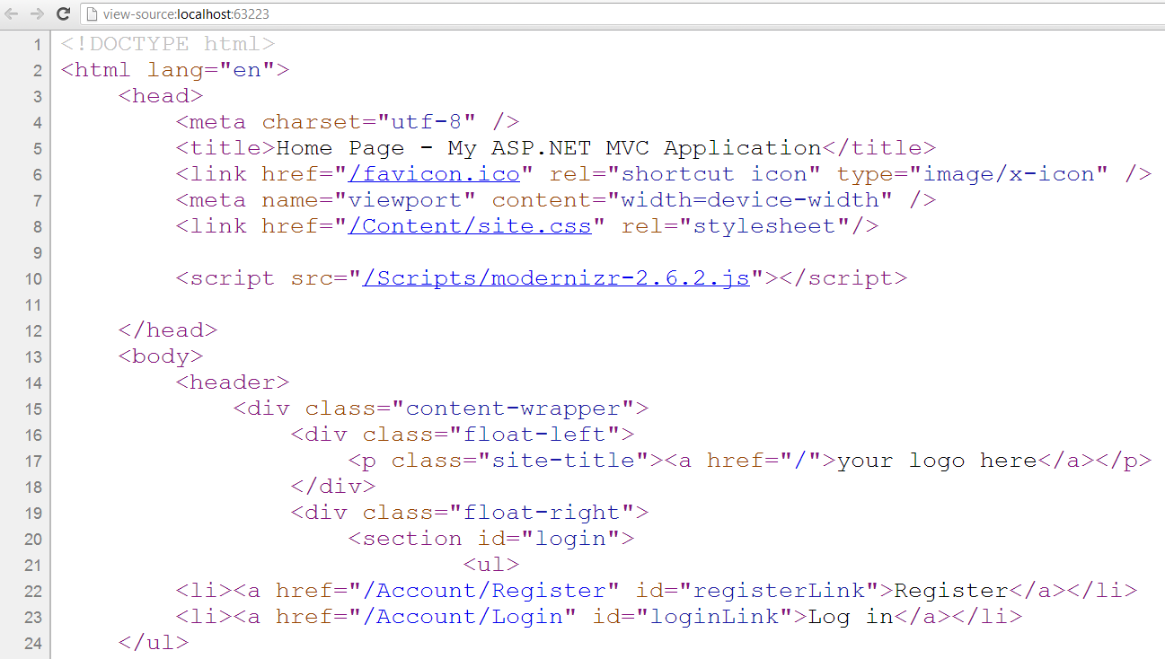
Default Layout for ASP.NET MVC Apps

Slide 29
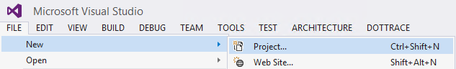
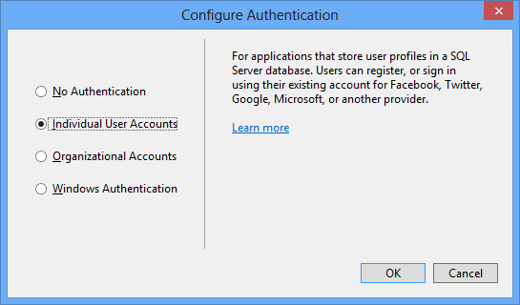
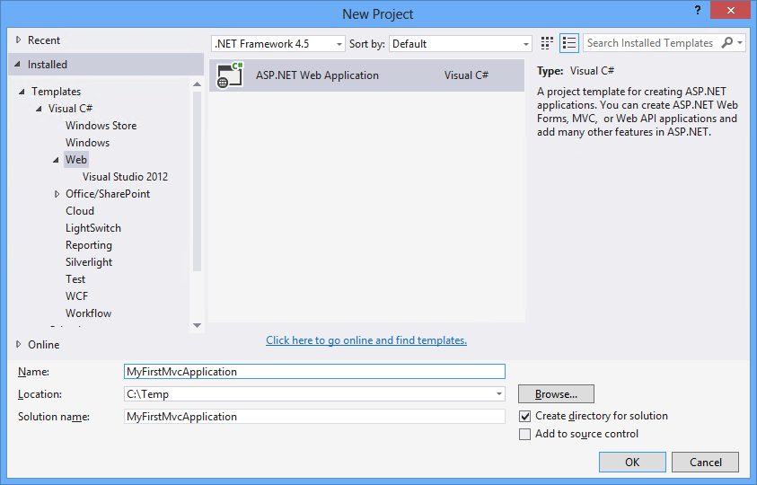
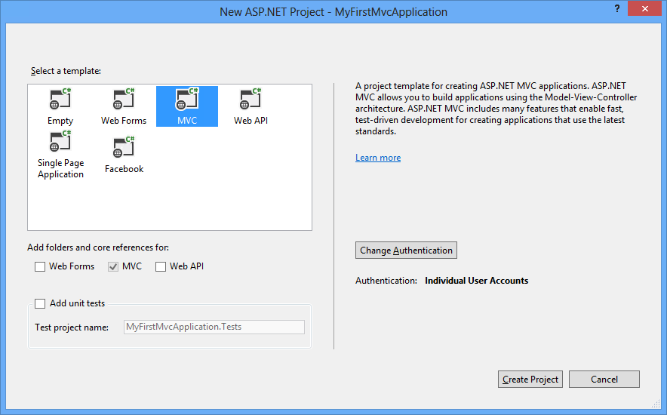
Visual Studio 2013: New Project

Slide 30
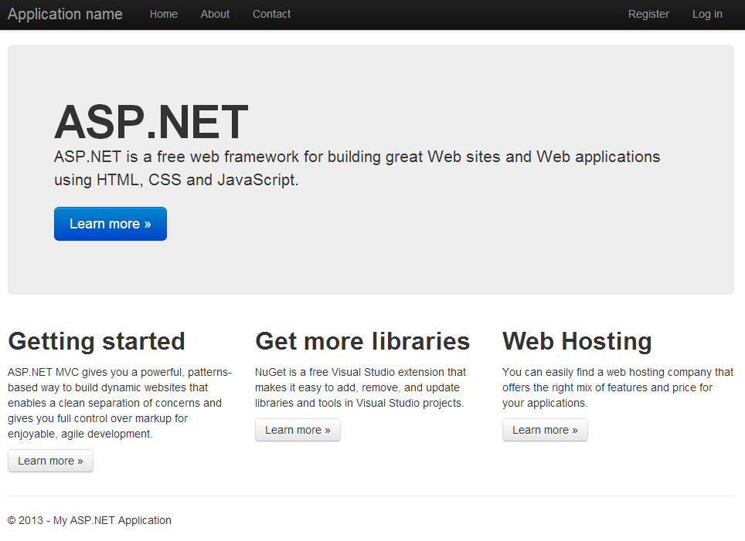
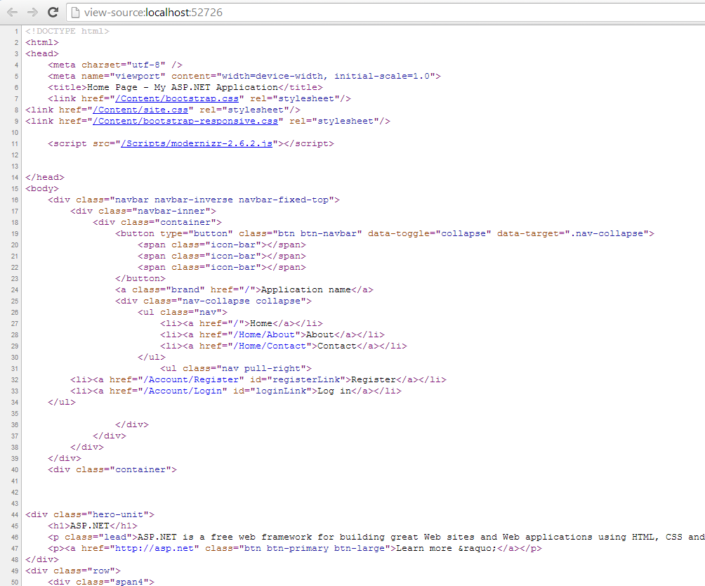
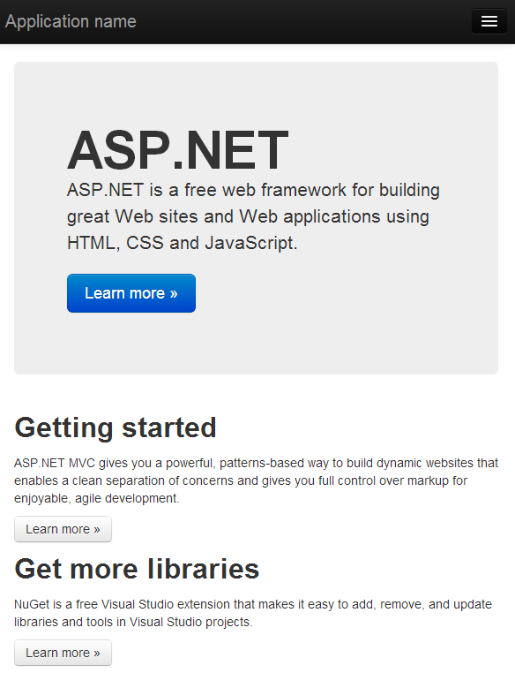
VS 2013: Default Layout

Slide 31
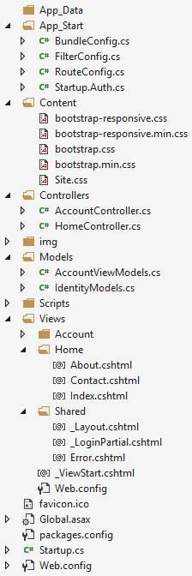
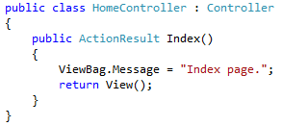
Internet App Project Files
Static files (CSS, Images, etc.)
All controllers and actions
JavaScript files (jQuery, Modernizr, knockout, etc.)
View templates
_Layout.cshtml – master page (main template)
Application_Start() – The entry point of the application
Web.config – Configuration file

Slide 32
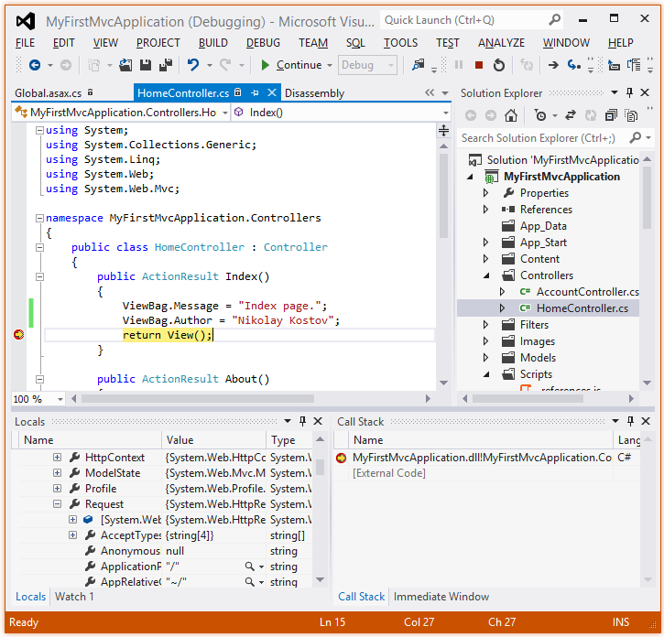
Demo: Web Application
Making Changes and Debugging

Slide 33

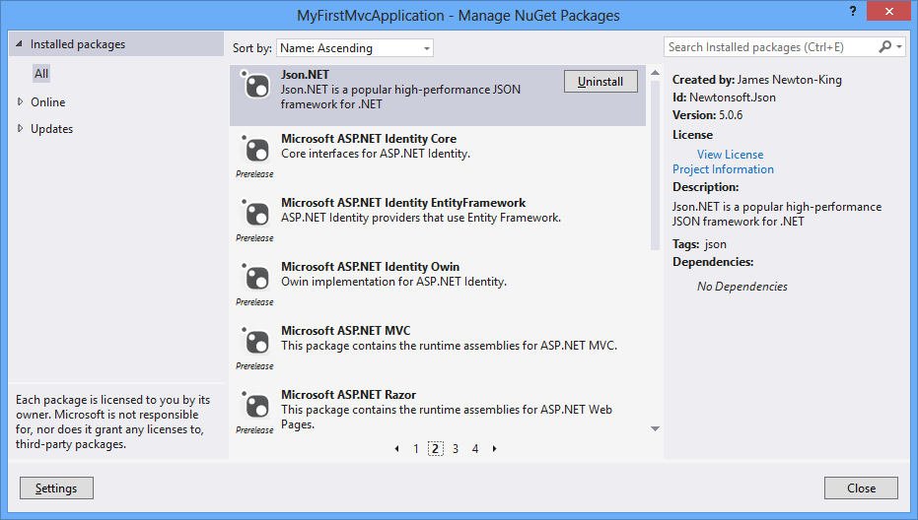
NuGet Package Management

Slide 34
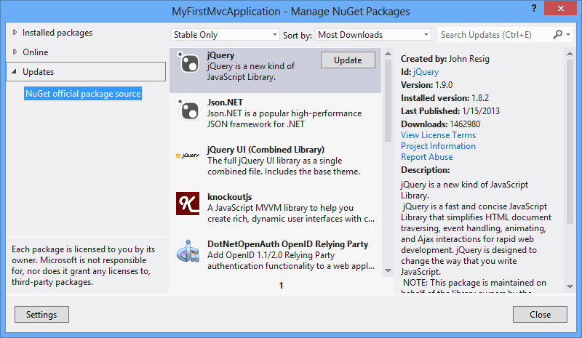
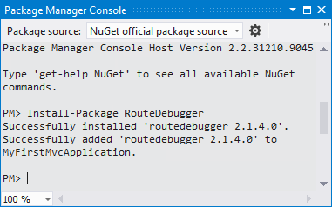
NuGet Package Management
Free, open source package management
Makes it easy to install and update open source libraries and tools
Part of Visual Studio 2012/2013
Configurable package sources
Simple as adding a reference
GUI-based package installer
Package manager console

Slide 35
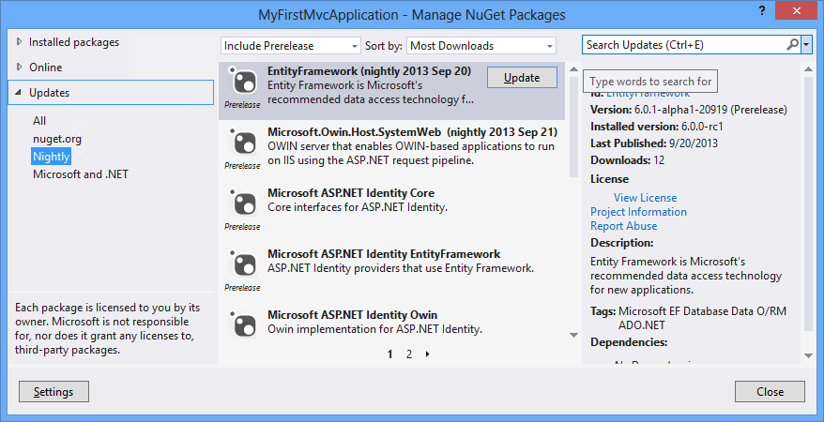
Nightly Builds
Nightly builds of ASP.NET MVC are available via a private NuGet feed
In your Package Manager settings add the following package source:
http://www.myget.org/F/aspnetwebstacknightly/

Slide 36
Demo: NuGet
Install and Update Packages

Slide 37
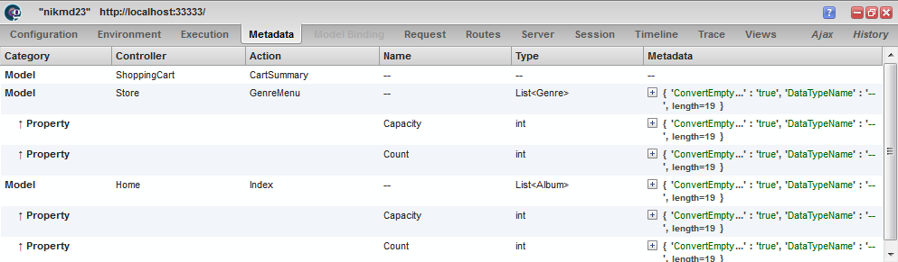

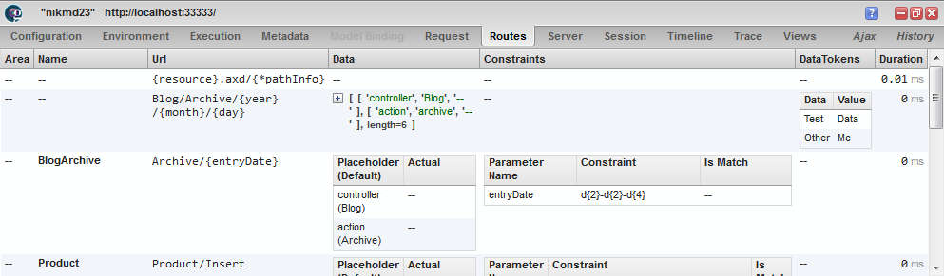
Server Information with Glimpse
The Open Source Diagnostics Platform of the Web

Slide 38
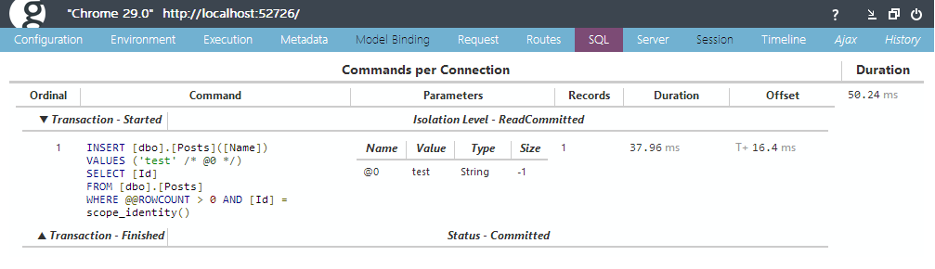
Server Info with Glimpse
Glimpse shows execution timings, server configuration, request data and more
Showed inside browser (like FireBug)
With no changes to the application code
Supports ASP.NET MVC, WebForms and EF

Slide 39
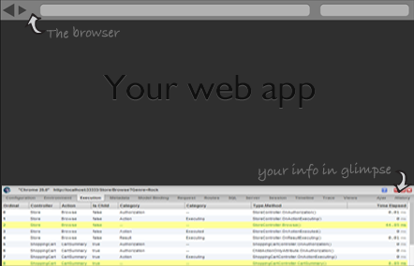
Install Glimpse
Install NuGet packages:
Glimpse.Mvc5
Glimpse.EF6
Run the project
Configure it:
http://localhost:port/Glimpse.axd

Slide 40
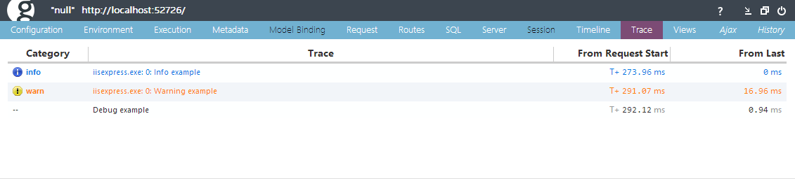
Tracing with Glimpse
The Trace tab shows any messages during the lifetime of the HTTP request traced to:
System.Diagnostics.Trace or System.Diagnostics.Debug
Trace.TraceInformation("Info example");
Trace.TraceWarning("Warning example");
Debug.WriteLine("Debug example");

Slide 41
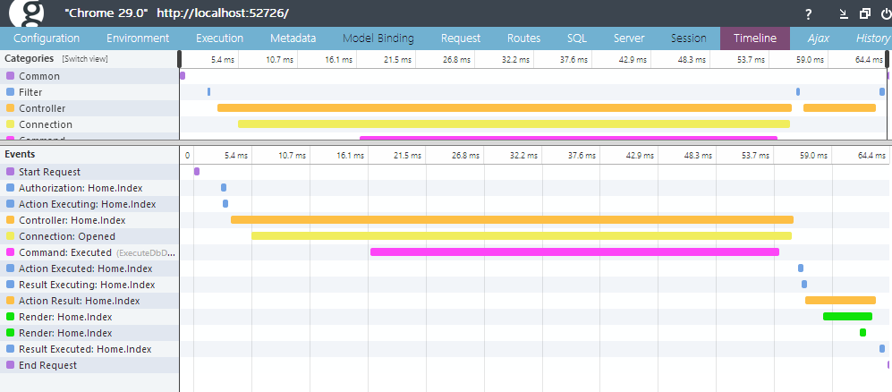
Demo: Glimpse

Slide 42
Summary
Model–view–controller (MVC) is a software architecture pattern
ASP.NET MVC is a great platform for developing Internet applications
Visual Studio is the main development tool for creating ASP.NET MVC applications
Almost everything in ASP.NET MVC is a package
Glimpse is a tool that helps with debugging

Slide 43
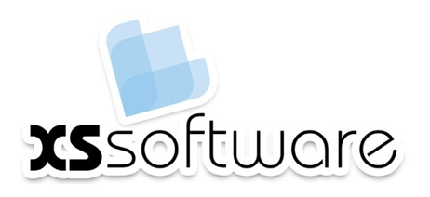








ASP.NET MVC – Introduction
https://softuni.bg/courses/asp-net-mvc/

Slide 44
License
This course (slides, examples, demos, videos, homework, etc.) is licensed under the "Creative Commons Attribution-NonCommercial-ShareAlike 4.0 International" license
Attribution: this work may contain portions from
"ASP.NET MVC" course by Telerik Academy under CC-BY-NC-SA license

Slide 45




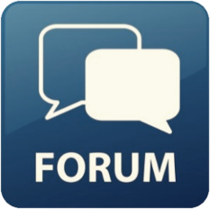
Free Trainings @ Software University
Software University Foundation – softuni.org
Software University – High-Quality Education, Profession and Job for Software Developers
softuni.bg
Software University @ Facebook
facebook.com/SoftwareUniversity
Software University @ YouTube
youtube.com/SoftwareUniversity
Software University Forums – forum.softuni.bg

